Slide 1
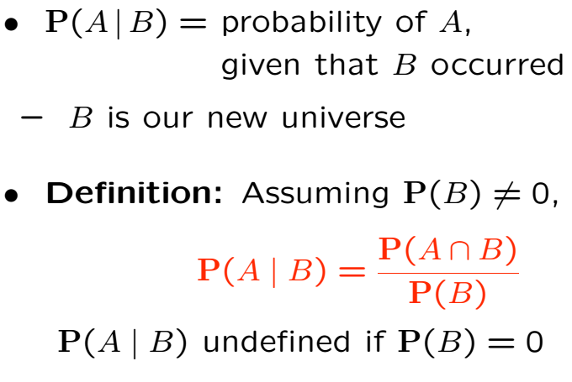
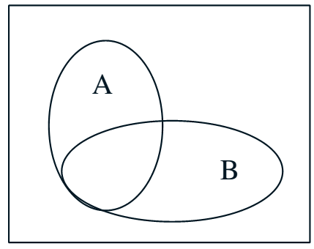
Conditional Probability

Slide 2
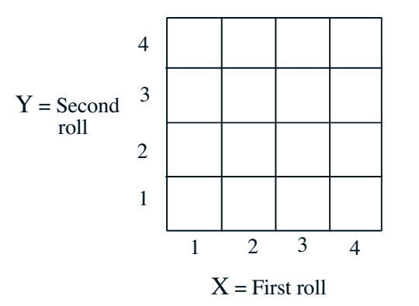
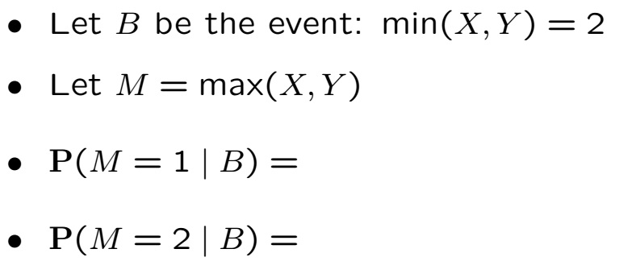
Die Roll Example

Slide 3
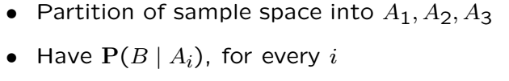
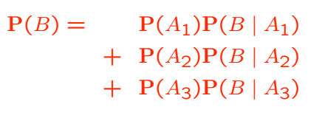
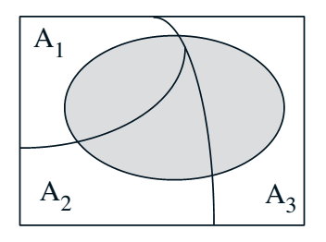
Total Probability Theorem

Slide 4
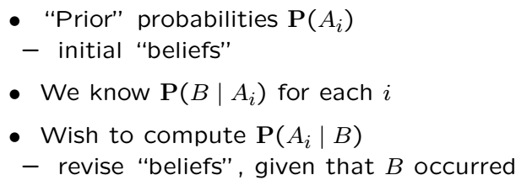
Bayes’ Rule
Systematic approach for incorporating new evidence
Thomas Bayes (1701-1761)

Slide 5
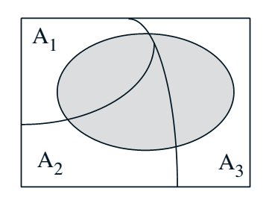
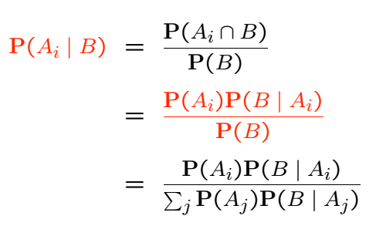
Bayes’ Rule Cont’

Slide 6
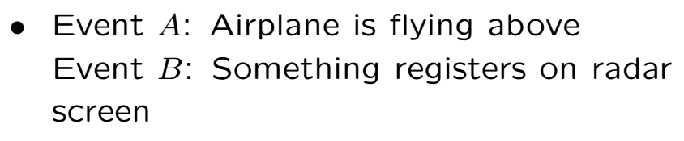
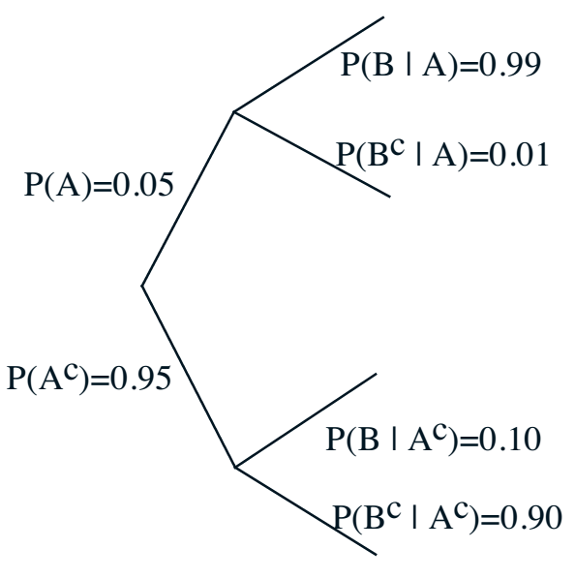
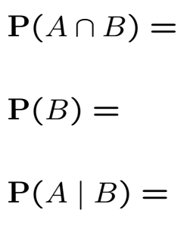
Models Based on Cond. Prob.

Slide 8

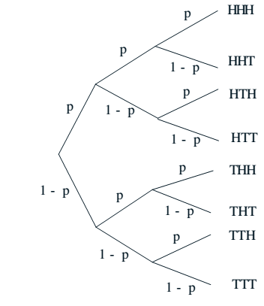
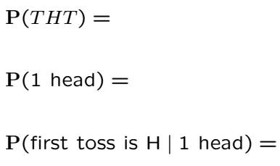
Sequence of Coin Tosses

Slide 10
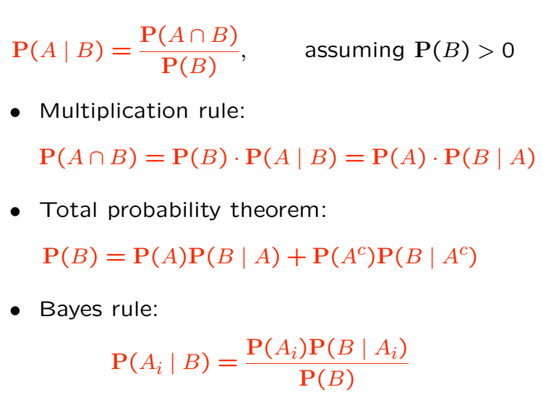
Review

Slide 11
Acknowledgements and Citations
Parts of these slides are adapted from the following resources:
Power Point Lecture Slides for the Textbook http://bcs.wiley.com/hebcs/Books?action=index&bcsId=8676&itemId=1118324560
John Tsitsiklis. 6.041 Probabilistic Systems Analysis and Applied Probability, Fall 2010. (Massachusetts Institute of Technology: MIT OpenCourseWare),http://ocw.mit.edu (Accessed 13 Apr, 2015). License: Creative Commons BY-NC-SA

